Slide 1
Gun Permits Analysis
By Marcus Garnham

Slide 2
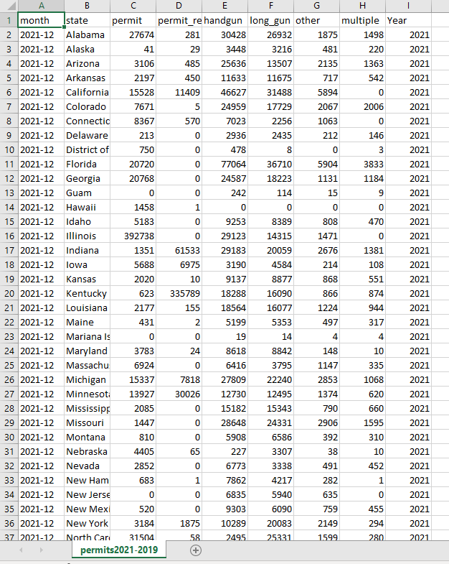
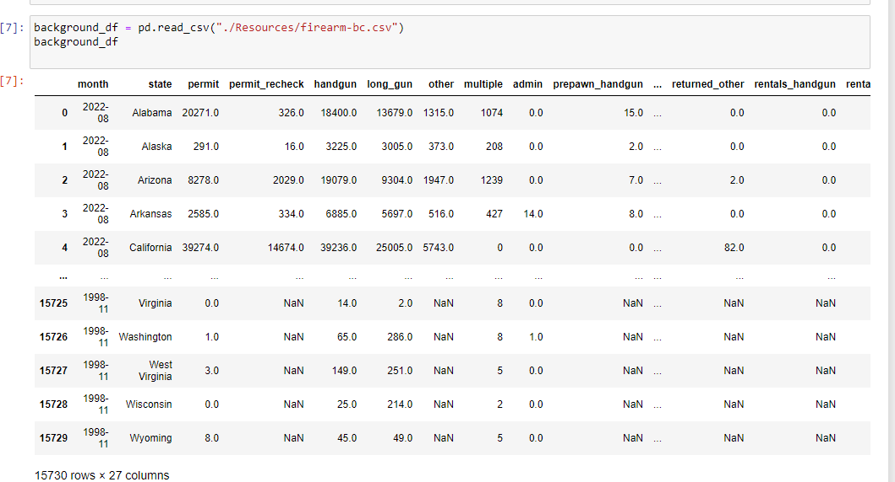
Initial Permit Data
The table was then outputted as a csv file which I am using excel to view in this image. The years in the table are from 2021-2019
Here is the raw data provided to Buzzfeed by a branch of the American government. Had to cut down columns and by the years and remove unwanted columns and then remove columns with no data to provide a clean table of data.

Slide 3
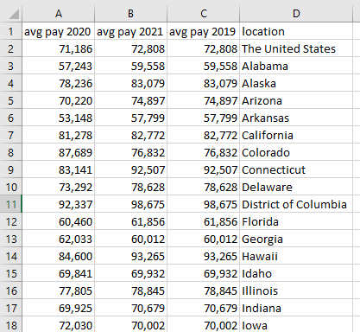
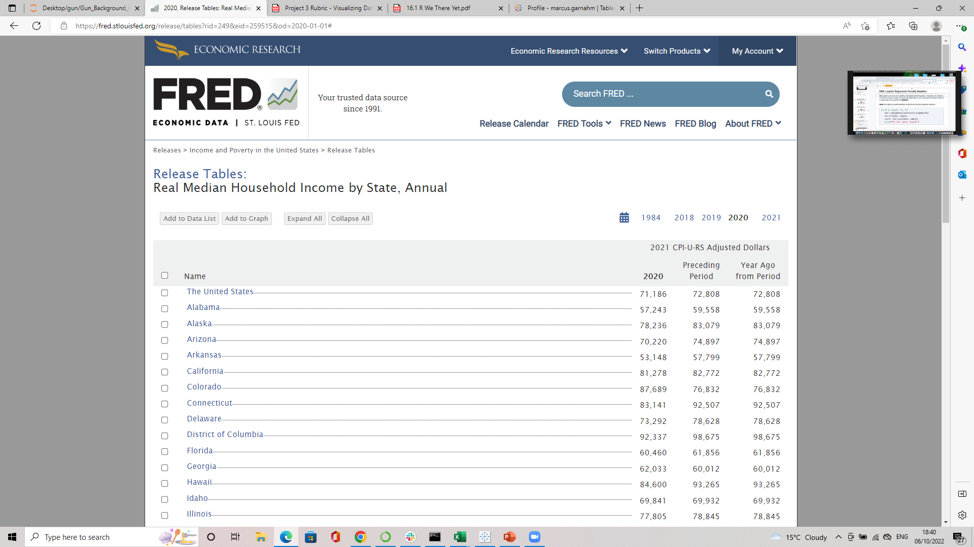
State Average Pay Data
Here is the website I scraped the average pay by state data for the USA. It required a lot of work cleaning and breaking down the data back into its separate columns.
URL = 2020, Release Tables: Real Median Household Income by State, Annual | FRED | St. Louis Fed (stlouisfed.org)
This is the clean csv I got after all my cleaning and scraping.

Slide 4
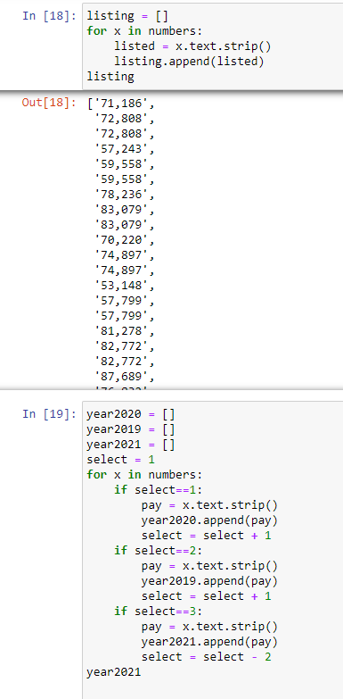
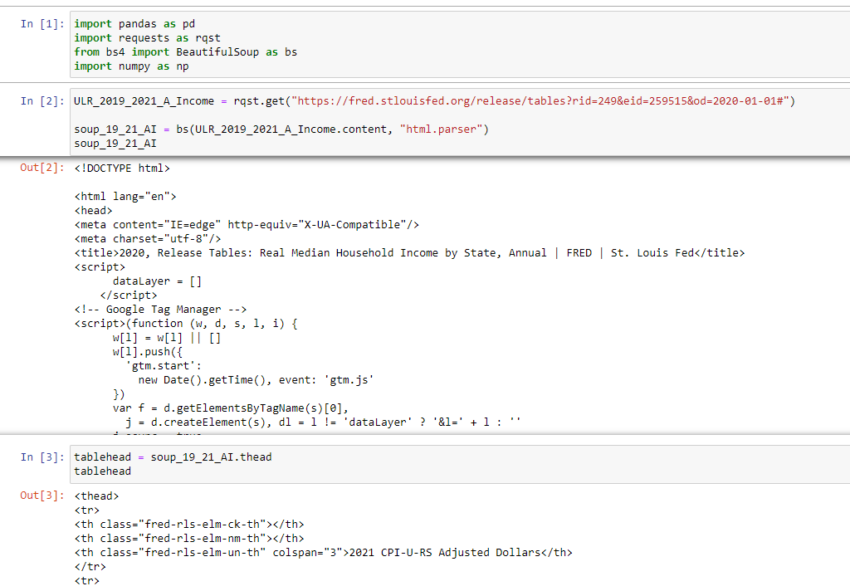
Examples of Scrape Code

Slide 5
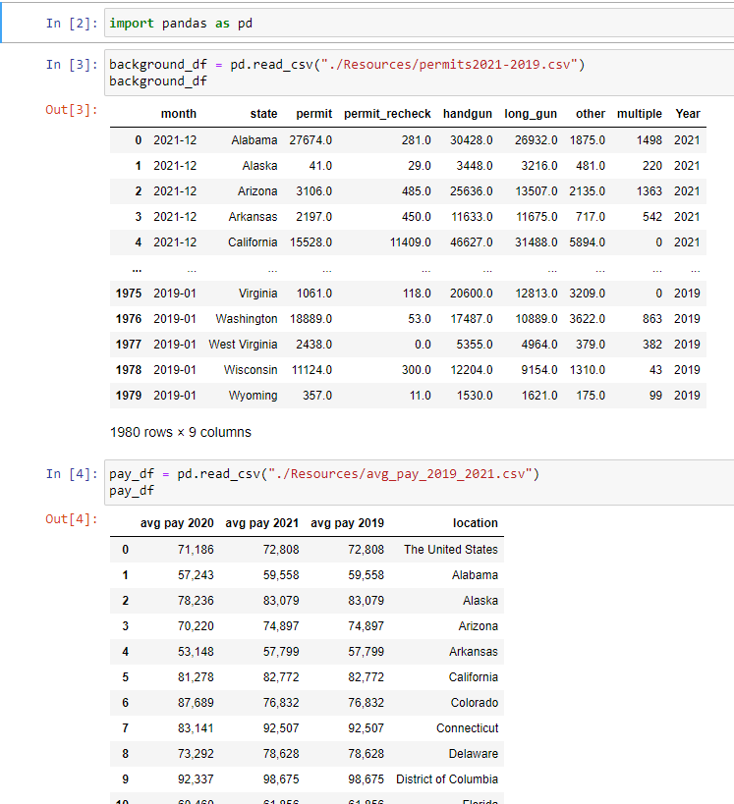
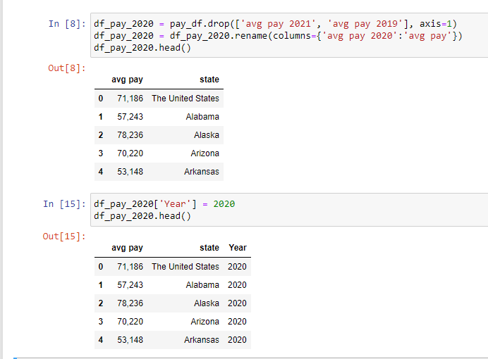
Combining Clean CSV Files
I had to load in the CSV files which I did in a new data frame however if I had time then I would have done it all in one file if I had the time to make them all look nice.
I had to separate out average pay for each year so I could get them into a format where I they had a year column and could be concatenated and joined to the permit data.

Slide 6
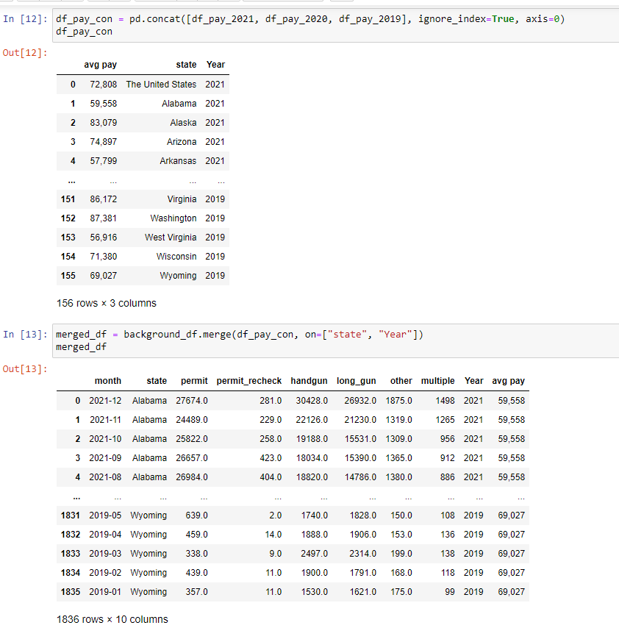
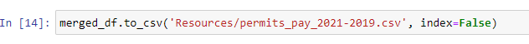
Once this coding was complete and new completed file was outputted and saved as a CSV that could be used later.
Which would have eventually been put into a database of some sort so we could then be utilised by other applications. Including having it in my java script.

Slide 7
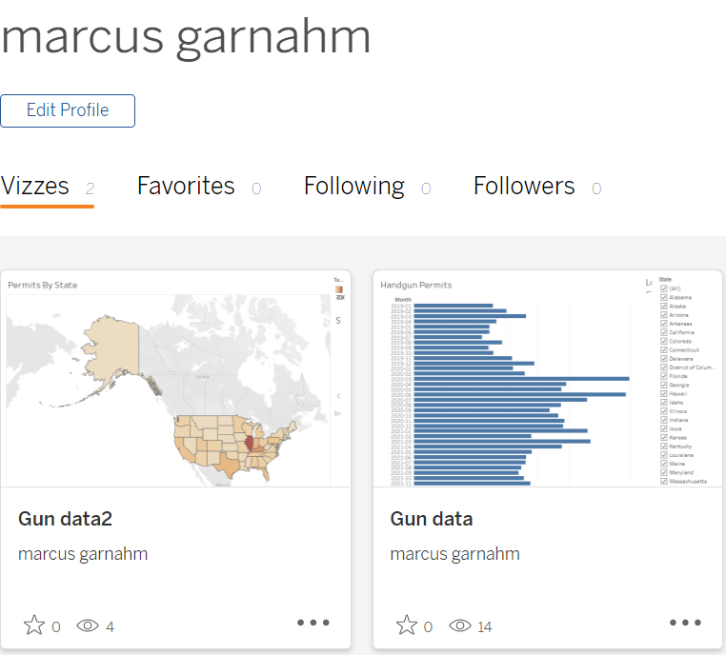
Visualisations Made In Tableau
I managed to make a few visualisations which could have been linked into the final website or been inspiration/blueprints for what we wanted to include.
Lets look at them by following the links on the next page.

Slide 8
Links To Visualisations
Gun data | Tableau Public
Gun data2 | Tableau Public
Gun data3 | Tableau Public

Slide 9
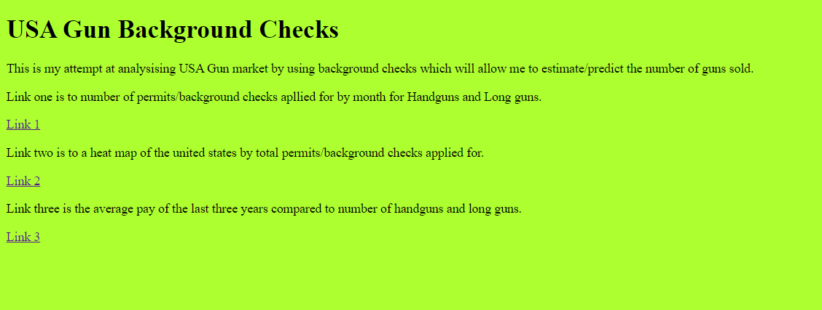
Basic Webpage

